Slide 1
Problem Statement
PS-17 Business Contract Validation - To classify content within the contract clauses and to determine the deviations from template
Manav Garg – 21bai1045 – vellore institute of technology, chennai

Slide 2
Unique Idea (Solution)
Our solution for Business Contract Validation involves a comprehensive and automated approach to manage and validate rental agreements using advanced Natural Language Processing (NLP) techniques. The key components of our solution include:
Named Entity Recognition (NER):
Utilizes Transformer-based models to identify and extract key entities such as names, dates, and locations from the contract.
Deviation Detection:
Compares clauses in the contract against a predefined template to identify any deviations, ensuring compliance and highlighting discrepancies.
Semantic and Sentiment Analysis:
Analyzes the semantic content and sentiment of the contract clauses to understand the tone and intent, helping in risk assessment and decision-making.

Slide 3
Unique Idea (Solution)
4. PDF Highlighting:
Automatically highlights relevant sections in the contract PDF for quick reference, improving readability and efficiency.
5. Optical Character Recognition (OCR):
Converts scanned documents into editable and searchable text, enabling seamless processing of physical contracts.
6. Streamlit Frontend & FastAPI Backend:
Provides an intuitive and user-friendly interface for users to interact with the system, and a robust backend to handle the processing and analysis tasks efficiently.
7. Hierarchical Directory Structure:
Organizes contracts and associated files in a structured manner, ensuring easy access and management.

Slide 4
Features Offered
Automated Contract Parsing: Automatically extracts and processes contract text using advanced NLP techniques.
Named Entity Recognition (NER): Identifies and highlights key entities such as names, dates, and organizations within the contract.
Deviation Detection: Compares contract clauses with a predefined template to detect and highlight deviations.
Semantic and Sentiment Analysis: Analyzes the meaning and tone of contract clauses to assess intent and sentiment, aiding in risk evaluation.
PDF Highlighting: Highlights critical sections of the contract directly in the PDF, making it easier for users to spot important information.
Optical Character Recognition (OCR): Converts scanned documents into editable text, facilitating the processing of physical contracts.
User-Friendly Interface: Utilizes Streamlit for a seamless and intuitive frontend experience, allowing users to easily interact with the system.
Robust Backend: Powered by FastAPI, ensuring efficient processing, scalability, and reliability.
Structured File Management: Maintains a hierarchical directory structure for organized and easy access to contract files.
Customizable Templates: Allows for the creation and management of custom templates to suit specific business needs and compliance requirements.
Comprehensive Reporting: Generates detailed reports highlighting entities, deviations, and sentiment analysis, providing valuable insights for decision-making.
Secure and Scalable: Ensures data security and supports scalability to handle varying volumes of contracts.

Slide 5
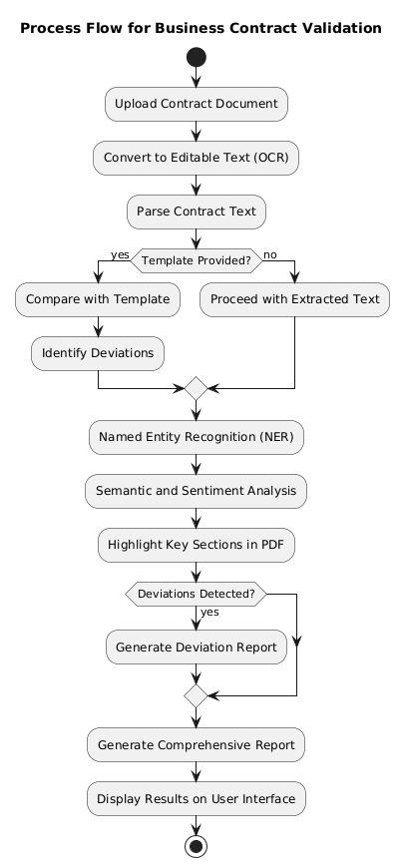
Process Flow
Start: The process begins with the initiation of the Business Contract Validation system.
Upload Contract Document: The user uploads the contract document through the user interface. This document can be in various formats such as PDF, DOCX, etc.
Convert to Editable Text (OCR): If the uploaded document is scanned or in a non-editable format, Optical Character Recognition (OCR) is used to convert it into editable text.
Parse Contract Text: The system parses the contract text to extract relevant information such as clauses, terms, and entities.
Template Provided?: The system checks if a standard template has been provided for comparison.
Yes: If a template is provided, the system compares the parsed text with the template to identify deviations.
No: If no template is provided, the system proceeds with the extracted text for further analysis.
Named Entity Recognition (NER): The system uses Named Entity Recognition to identify and categorize key entities such as persons, organizations, locations, dates, and monetary values within the contract text.

Slide 6
Process Flow
Semantic and Sentiment Analysis: The system performs semantic analysis to understand the meaning of the contract clauses and sentiment analysis to determine the tone (positive, negative, neutral) of the text.
Deviations Detected?: The system checks if there are any deviations from the provided template or standard terms.
Yes: If deviations are detected, the system generates a deviation report detailing the differences.
No: If no deviations are detected, the system proceeds to generate the final report.
Generate Comprehensive Report: A comprehensive report is generated, summarizing the findings, including NER results, sentiment analysis, and identified deviations.
Display Results on User Interface: The results are displayed on the user interface, providing the user with a clear and concise overview of the contract analysis.
Stop: The process ends, and the system waits for further user input or the next contract document upload.

Slide 7
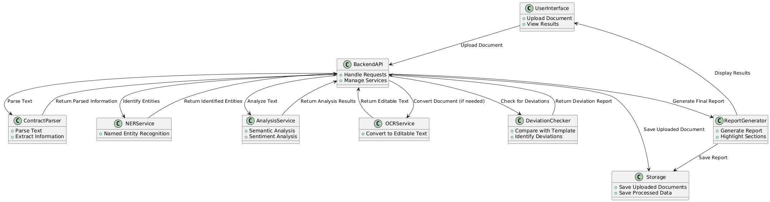
Architecture Diagram

Slide 8
Technologies Used

Slide 9
Technologies Used
Natural Language Processing (NLP):
Transformers: Utilized for advanced NLP tasks like Named Entity Recognition (NER), Semantic Analysis, and Sentiment Analysis.
spaCy: Used for efficient and effective parsing of contract text and entity recognition.
Hugging Face: Leveraged for transformer models to enhance NLP capabilities.
Optical Character Recognition (OCR):
Tesseract: Employed to convert scanned documents or images of text into editable and searchable text formats.
Backend Development:
FastAPI: Framework for building the backend API, handling requests, and managing services efficiently.
Python: The primary programming language used for implementing the backend logic and services.
Frontend Development:
Streamlit: Used for creating an intuitive and interactive user interface for uploading documents and viewing results.

Slide 10
Technologies Used
APIs and Integrations:
REST APIs: Implemented for communication between the frontend and backend, ensuring seamless data exchange.
Third-party NLP APIs: Utilized for additional language processing capabilities when needed.

Slide 11
Contribution
Manav garg – developer
Sudheer kumar e - mentor

Slide 12
Conclusion
The Business Contract Validation system represents a significant advancement in automating the analysis and validation of rental agreements. By leveraging state-of-the-art Natural Language Processing (NLP) techniques, Optical Character Recognition (OCR), and robust backend and frontend technologies, the system offers a comprehensive solution for identifying deviations from templates, classifying contract content, and providing detailed reports. This not only enhances the accuracy and efficiency of contract validation but also reduces the time and effort required for manual reviews. Overall, the implementation showcases the power of modern AI and software development practices in solving real-world business challenges.

